Slide 1
Responding to events
You can respond to events by declaring event handler functions inside your components:
Notice how onClick={handleClick} has no parentheses at the end! Do not call the event handler function: you only need to pass it down. React will call your event handler when the user clicks the button.
let App = function () {
function handleClick() {
alert('You clicked button!');
}
return (
<button onClick={handleClick}>
Click
</button>
);
}
export default App;
let App = function () {
//const handleClick=;
return (
<button onClick={()=>alert('You clicked button!')}>
Click
</button>
);
}
export default App;

Slide 2
function App() {
return (
<Toolbar
onPlayMovie={() => alert('Playing!')}
onUploadImage={() => alert('Uploading!')}
/>
);
}
Button({ children:Play Movie onData:onPlayMovie});
function Button({ onClick, children }) {
return (
<button onClick={onClick}>
{children}
</button>
);
}
function Toolbar({ onPlayMovie, onUploadImage }) {
return (
<div>
<Button onClick={onPlayMovie}>
Play Movie
</Button>
<Button onClick={onUploadImage}>
Upload Image
</Button>
</div>
);
}
Try printing obj in console to understand children
function Button(obj) {
console.log(obj)
return (
<button onClick={obj.onClick}>
{obj.children}
</button>
);
}

Slide 3
Updating the screen
Often, you’ll want your component to “remember” some information and display it. For example, maybe you want to count the number of times a button is clicked. To do this, add state to your component.
You’ll get two things from useState: the current state (count), and the function that lets you update it (setCount). You can give them any names, but the convention is to write [something, setSomething].
The first time the button is displayed, count will be 0 because you passed 0 to useState(). When you want to change state, call setCount() and pass the new value to it. Clicking this button will increment the counter:
React will call your component function again. This time, count will be 1. Then it will be 2. And so on.
If you render the same component multiple times, each will get its own state. Click each button separately:

Slide 4
const React = (function () {
let hooks = [];
let idx = 0;
function useState(initVal) {
const _idx = idx;
console.log(_idx) // 0, 1
const state = hooks[idx] || initVal;
const setState = newVal => {
hooks[_idx] = newVal;
};
idx++;
return [state, setState];
}
function render(Component) {
idx = 0;
const C = Component();
C.render();
return C;
}
return { useState, render };
})();
function Component() {
const [count, setCount] = React.useState(1);
const [text, setText] = React.useState('apple');
return {
render: () => console.log({ count, text }),
click: () => setCount(count + 1),
type: (word) => setText(word),
}
}
var App = React.render(Component);
// {count: 1, text: "apple"}
App.click();
var App = React.render(Component);
// {count: 2, text: "apple"}
App.type('pear');
var App = React.render(Component);
// {count: 2, text: "pear"}

Slide 5
import { useState } from 'react';
export default function App() {
return (
<div>
<h1>Counters that update separately</h1>
<MyButton />
<MyButton />
</div>
);
}
function MyButton() {
const [count, setCount] = useState(0);
function handleClick() {
setCount(count + 1);
}
return (
<button onClick={handleClick}>
Clicked {count} times
</button>
);
}
function()
{
count=count+1;
}

Slide 6
Using Hooks
Functions starting with use are called Hooks. useState is a built-in Hook provided by React. You can find other built-in Hooks in the API reference. You can also write your own Hooks by combining the existing ones.
Hooks are more restrictive than other functions. You can only call Hooks at the top of your components (or other Hooks). If you want to use useState in a condition or a loop, extract a new component and put it there.
Read 1st 07 Routparameter hooks

Slide 7
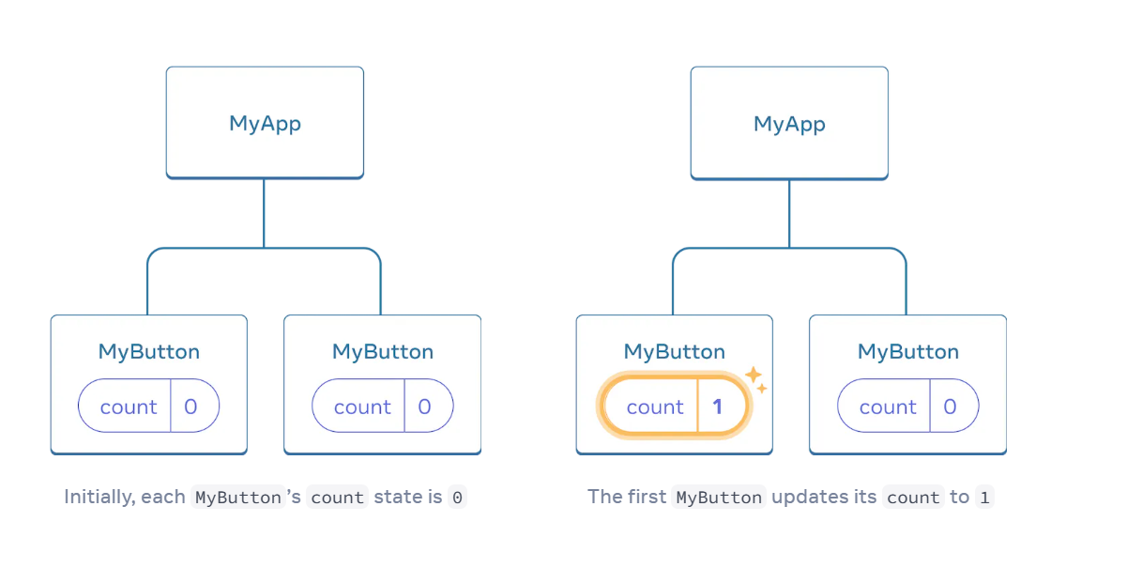
MyButton had its own independent count, and when each button was clicked, only the count for the button clicked changed:

Slide 8
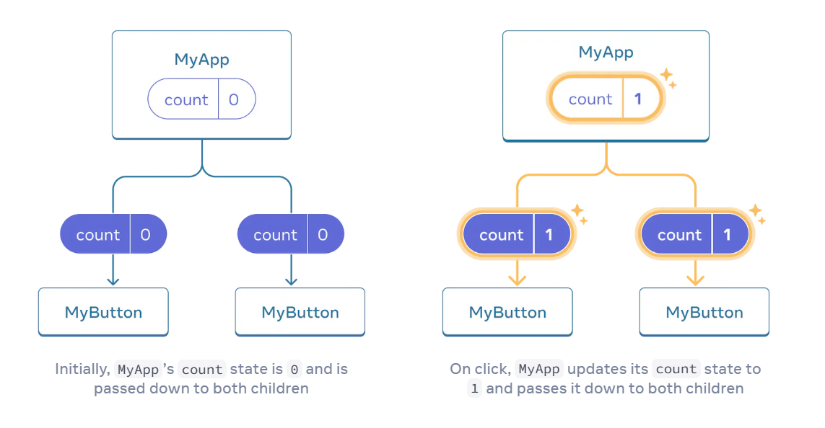
However, often you’ll need components to share data and always update together.
To make both MyButton components display the same count and update together, you need to move the state from the individual buttons “upwards” to the closest component containing all of them.
In this example, it is MyApp:

Slide 9
Now when you click either button, the count in MyApp will change, which will change both of the counts in MyButton. Here’s how you can express this in code.
First, move the state up from MyButton into MyApp:
import { useState } from 'react';
export default function MyApp() {
const [count, setCount] = useState(0);
function handleClick() {
setCount(count + 1);
}
return (
<div>
<h1>Counters that update together</h1>
<MyButton count={count} onClick={handleClick} />
<MyButton count={count} onClick={handleClick} />
</div>
);
}
function MyButton({ count, onClick }) {
return (
<button onClick={onClick}>
Clicked {count} times
</button>
);
}

Slide 10
Now when you click either button, the count in MyApp will change, which will change both of the counts in MyButton. Here’s how you can express this in code.
First, move the state up from MyButton into MyApp:
Then, pass the state down from MyApp to each MyButton, together with the shared click handler. You can pass information to MyButton using the JSX curly braces,
The information you pass down like this is called props. Now the MyApp component contains the count state and the handleClick event handler, and passes both of them down as props to each of the buttons.
Finally, change MyButton to read the props you have passed from its parent component:
When you click the button, the onClick handler fires. Each button’s onClick prop was set to the handleClick function inside MyApp, so the code inside of it runs. That code calls setCount(count + 1), incrementing the count state variable. The new count value is passed as a prop to each button, so they all show the new value. This is called “lifting state up”. By moving state up, you’ve shared it between components.

